Slide 1

The Jury Journey:
From Voiceless to Volunteer
Indigenous Jury Representation
The Indigenous Justice Forum
September 28, 2018
Litigation with a conscience.
Main Office: 10 Alcorn Avenue, Suite 204, Toronto ON M4V 3A9 Phone: (416) 964-0495 Fax: (416) 929-8179
Northern Office: 104 Syndicate Avenue North, Suite 200, Thunder Bay, ON P7C 3V7 Phone: (807) 622-4900 Fax: (416) 929-8179

Slide 2


THE JURY JOURNEY
Jamie Goodwin and Ricardo Wesley: The Kashechewan Inquest
The Peacock Affidavit
Jacy Pierre
NAN v Eden
R v Wareham
Iacobucci Review
Project Invite
R v Kokopenace
Colton Boushie

Slide 3
THE KASHECHEWAN INQUEST
Ricardo Wesley and Jaime Goodwin died on January 8th, 2006, in the cellblock of the Nishnawbe-Aski Police Service detachment in Kashechewan.
Pre-inquest motions were heard and raised concerns about the adequacy of the jury roll that was used in the Kenora district, as the five jurors were not from Kashechewan.
In response, Coroner’s Counsel filed the Peacock affidavit.

Slide 4
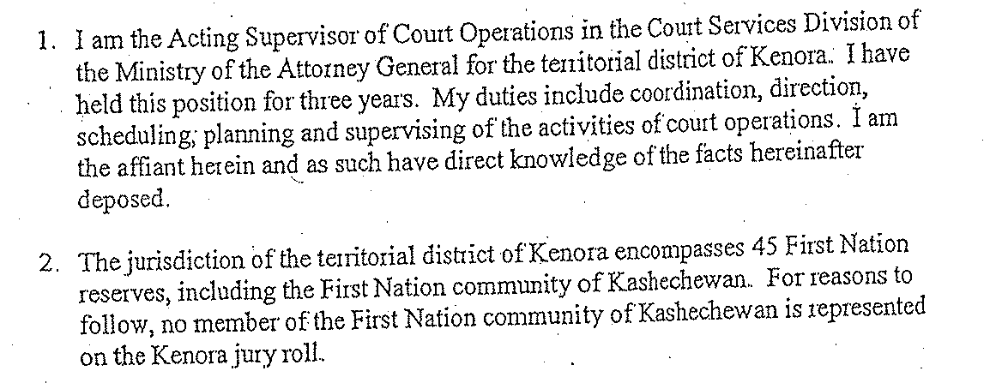
THE PEACOCK AFFIDAVIT

Slide 5
WHY?
Under the Juries Act, the sheriff prepares a jury roll each year.
The roll is composed of people who have been sent and have returned a jury service notice.
The persons randomly selected to receive a notice are taken from municipal service lists.
The names of persons on reserves are not included on those lists.
Section 6(8) prescribes an alternative procedure for First Nations people living on reserve, stating that the sheriff may obtain the names from any record available.
Until 2000, INAC had provided band electoral lists. When INAC stopped providing these, little was done to obtain other records.

Slide 6
JACY PIERRE, REGGIE BUSHIE, and the THUNDER BAY DISTRICT
Jacy Pierre and Reggie Bushie were both young Indigenous men who died in Thunder Bay.
Before their inquests began, their families and Nishnawbe Aski Nation again raised concerns about the representativeness of the jury roll.
They asked for a summons to the Director of Court Operations, to find out how the jury roll in the District of Thunder Bay was established.
The motions were denied and these decisions were appealed.

Slide 7
NAN v EDEN
The Ontario Court of Appeal, in March 2011, described the jury roll as "manifestly unrepresentative" of First Nations people, and declared that inquest proceedings without a properly representative jury were invalid.
(NAN v. Eden, 2011 ONCA 197)

Slide 8

NAN v EDEN

Slide 9
R v WAREHAM VOIR DIRE
[6] Therefore of the jury panel as comprised, (which I might say offers no assistance as to whether there are any individuals resident on the reserves in the Thunder Bay District), I am drawn to the conclusion that the panel is not representative in the sense that is contemplated by the Court of Appeal in Pierre v. McRae and understanding that this voir dire is distinct from the challenge to the array contemplated in the Criminal Code.
[Justice Pierce, March 2011]

Slide 10
CRISIS IN THE JUSTICE SYSTEM
Jury Roll Issues Could Cripple the Justice System
Judicial Inquiry into Local Jury Rolls Ordered
Jury Rolls in Crisis

Slide 11

ONTARIO ORDERS A REVIEW
Enhancing First Nations Representation On Juries
McGuinty Government Appoints Respected Jurist To Conduct Review
August 11, 2011, 6:00 P.M.
Former Supreme Court of Canada Justice, the Honourable Frank Iacobucci, will review the process for including individuals living in First Nations reserve communities on the province’s jury rolls.

Slide 12
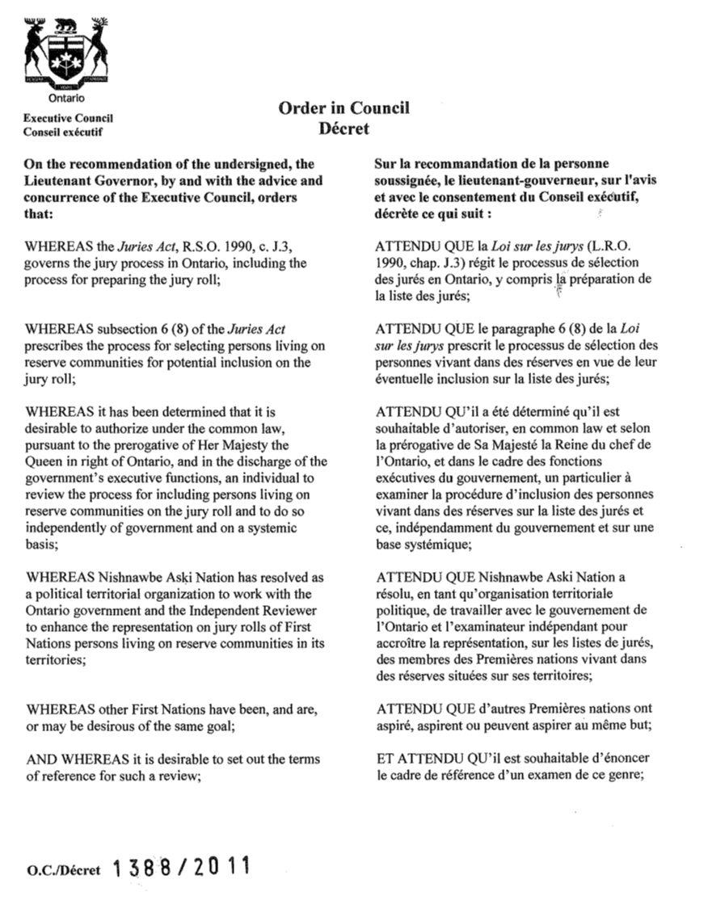

Slide 13
AN INDEPENDENT REVIEW
Mandate: The Independent Reviewer shall conduct a systemic review and report on any relevant legislation and processes for including First Nations persons living on reserve on the jury roll from which potential jurors are selected for all jury trials and coroners inquests, in order to make recommendations:
  a. to ensure and enhance the representation of First Nations persons living on reserve communities on the jury roll; and
  b. to strengthen the understanding, cooperation and relationship between the Ministry of the Attorney General and First Nations on this issue.

Slide 14
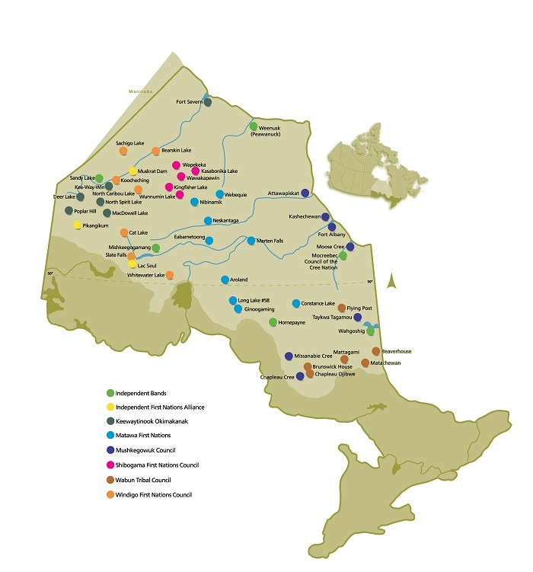
AN INDEPENDENT REVIEW (Continued)
The communities in which preparation and consultation meetings were conducted were as follows: Sachigo Lake, Sandy Lake, Keewaywin, Poplar Hill, Pikangikum, Kasabonika Lake, Webequie, Mishkeegogamang, Ginoogaming, Mattagami, Moose Cree, and Constance Lake.
In total, 24 preparation and consultation meetings were conducted by NAN and the Iacobucci Review team.

Slide 15
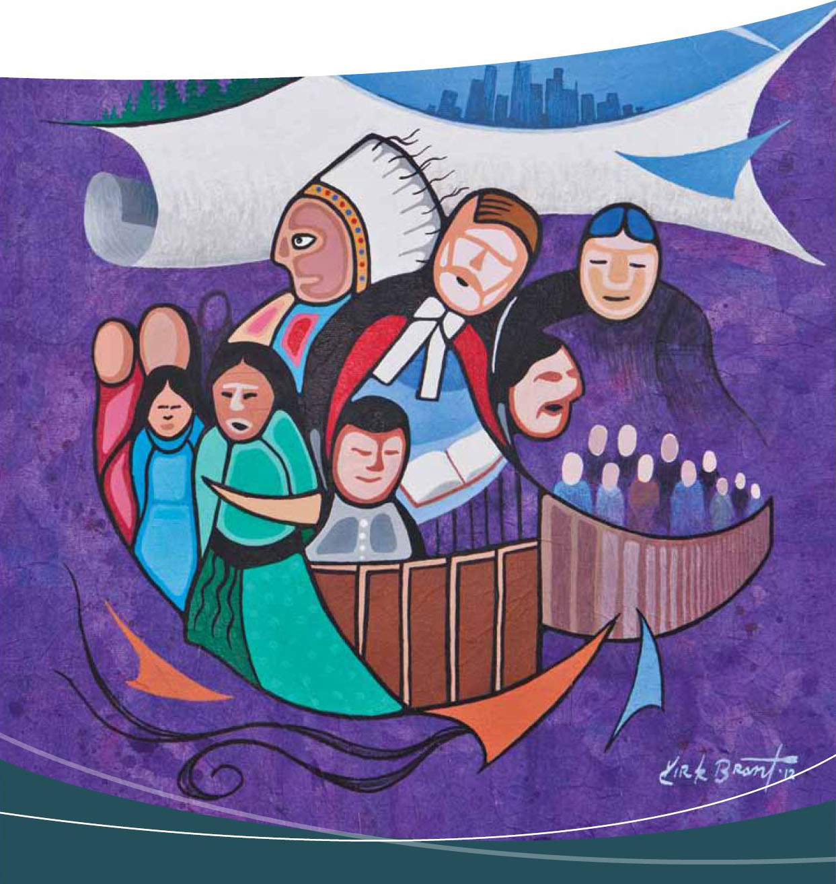
FIRST NATIONS REPRESENTATION ON ONTARIO JURIES (“IACOBUCCI REPORT”)
The justice system generally as applied to First Nations Peoples, particularly in the North, is quite frankly in a crisis. If we continue the status quo we will aggravate what is already a serious situation, and any hope of true reconciliation between First Nations and Ontarians generally will vanish. Put more directly the time for talk is over, what is desperately needed is action.
(para. 371)

Slide 16
IACOBUCCI REPORT (Continued)
Justice Iacobucci summarized some of these systemic issues as follows (para. 372):
  the conflict between First Nation and Euro-Canadian approaches to criminal justice;
  the systemic racism that remains present in the Ontario justice system, including instances of mistreatment of First Nation inmates in prison, general disrespect by police and discriminatory public reaction to First Nation complaints;
  the almost universally-held view of First Nation individuals that the justice system is alien or foreign;
  the problem of inadequate legal representation of First Nation individuals, particularly in the north, resulting in virtually automatic guilty pleas; and
  inadequate funding of police services and lack of enforcement of First Nation bylaws.
Justice Iacobucci pointed out that until this crisis in the justice system is resolved, the lack of representation of First Nation people on juries will continue.

Slide 17
IACOBUCCI REPORT (Continued)
RECOMMENDATION 12: the Ministry of the Attorney General, in consultation with the
Implementation Committee, consider a procedure whereby First Nations people on reserve
could volunteer for jury service as a means of supplementing other jury source lists. This is
practised in New York State as a way to supplement jury rolls drawn from several other lists
that might overlook certain individuals, and could serve a similarly valuable purpose with
respect to First Nations peoples in Ontario. By supplementing other jury source lists in this
manner, the Ministry of the Attorney General and the Implementation Committee would wish
to be satisfied that this would not offend the randomness principle.

Slide 18
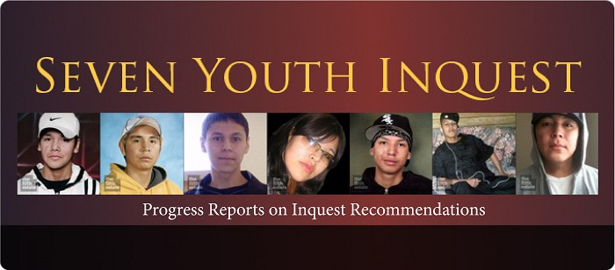
SEVEN YOUTH INQUEST
In addition to the independent review, the inquest into the death of Reggie Bushie was expanded to look into six other deaths in similar circumstances.
This was the largest, multi-death inquest in Canadian history.

Slide 19
IN THE MEANTIME… R v KOKOPENACE
The Court determined that the state met its representativeness obligation with regard to jury selection and that a fair opportunity was provided for a broad cross-section of society to participate in the jury process.
In dissent, Chief Justice McLachlin and Justice Cromwell stated that the jury roll was not representative due to its composition being a “substantial departure from what random selection among all potentially eligible jurors in the district would produce, in view of the under-representation of Aboriginal on-reserve residents on the jury roll.”
R v Kokopenace (2015 SCC 28)

Slide 20
PROJECT INVITE
The Seven Youth inquest was delayed while measures were being taken to address the issues with the jury roll – DESPITE the SCC ruling in Kokopenace;
Known as Project Invite, Ontario took up Recommendation #12 from the Iacobucci Report, travelling to 22 First Nations Communities.
Project Invite would see 473 Indigenous persons volunteer to be jurors for Coroners’ Inquests.

Slide 21
PROJECT INVITE (Continued)
Ontario Regulation 266/14 (under the Coroners Act) was drafted with the following purpose: “to provide for a pilot project in the territorial districts of Kenora and Thunder Bay to address the underrepresentation, on juries at coroners’ inquests of persons who reside on reserves.” The current version applies to inquests for which the jury is selected before December 31, 2018:
    Coroners Act
    ONTARIO REGULATION 266/14
    ON-RESERVE REPRESENTATION, JURIES AT CORONERS' INQUESTS, TERRITORIAL DISTRICTS OF KENORA AND THUNDER BAY
    Purpose
    1. The purpose of this Regulation is to provide for a pilot project in the territorial districts of Kenora and Thunder Bay to address the underrepresentation, on juries at coroners’ inquests, of persons who reside on reserves.
    Application
    2. This Regulation applies when,
    (a) an inquest is to be held in one of the territorial districts mentioned in section 1;
    (b) the Chief Coroner is of the opinion that following the procedure set out in sections 4 and 5 is desirable for the purpose of ensuring that the list from which jurors are selected for the inquest includes an appropriate number of persons who reside on reserves; and
    (c) the jury for the inquest is selected before December 31, 2018. O. Reg. 266/14, s. 2; O. Reg. 491/16, s. 1.

Slide 22
PROJECT INVITE (Continued)
Project Invite was limited to the territorial districts of Thunder Bay and Kenora. Within these two areas, twenty-two First Nation communities were visited by a team tasked with the creation of the Volunteer List. Within the traditional territory of Nishnawbe Aski Nation (NAN), the team visited twelve communities: Sandy Lake, Bearskin Lake, Kasabonika Lake, Keewaywin, Muskrat Dam, Sachigo, Webequie, Cat Lake, Eabametoong, Mishkeegogamang, Kashechewan and Pikangikum. Within Treaty #3 territory, the team visited Couchiching, Grassy Narrows, Wauzhushk Onigum, Lac Seul, and Naotkamegwanning. The team also visited the Independent and Anishinaabek Nation communities of Fort William, Red Rock, Pic River, Pic Mobert and Long Lake.

Slide 23
SEVEN YOUTH INQUEST: REPRESENTATIVE JURIES
The first beneficiary of the work of Project Invite was the Seven Youth Inquest.
Of the five person panel, one was a volunteer juror from Sachigo First Nation.
The Seven Youth Inquest resulted in over 100 recommendations to improve education and safety for First Nations children.

Slide 24
COLTEN BOUSHIE
Gerald Stanley (56-year-old farmer from Biggar, Sask), acquitted of second-degree murder in the shooting death of Colten Boushie (22-year-old man from Red Pheasant Cree Nation), on February 9, 2018.
Of 45 potential jurors selected at random, five appeared to be Indigenous, Mr. Murphy (the lawyer for the Boushie family) said. They were rejected by Stanley’s lawyer through peremptory challenges, which can be made without having to give a reason.
Jury reform is met with incredible resistance. Consider Nicholas Stooshinoff, president of the Saskatchewan Trial Lawyers Association, who believes Canada’s justice system is the finest in the world and doesn’t need an overhaul because of “knee-jerk” reactions to the Stanley verdict.
    “I have not seen any evidence or any indication that an all-First-Nations jury would not have come to the same conclusion,” Stooshinoff said. “There is an assumption among some individuals, politicians included, that this man was acquitted because of racism on the part of the jury.”

Slide 25
COLTEN
Today I grieve for my country.
I grieve for a family
that has not yet seen justice
from the moment a handgunned farmer
pulled the trigger and killed their son.
(why does a farmer need such a gun?)
I grieve for a mother
who saw the police
arrive at her house as though on a raid
and treat her like a criminal
and not like the victim she really was.
I grieve for those mothers
with empty arms
who think of their loss
at the hands of such others.
and the lack of the answers
that haunt them still.
…
Posted February 10, 2018 by Senator Murray Sinclair

Slide 26
COLTEN
…
I grieve for the youth
who now see no hope,
and whose hunger for justice
gives rise to an anger
that more and more turns
from a dangling rope
to a violence directed at them.
I grieve for the children
whose lives have embraced
an unwanted, dangerous, jeopardy.
I grieve for the elders
who’ve seen this before.
And whose wisdom will not be enough
to get all of us through this evenly.
…

Slide 27
COLTEN
…
I may grieve for some time to come.
But then to be true…
we have all been in grieving a very long time.
So long, it is part of our DNA
And so, this is why
No matter how hard we might try
we can’t “just get over it and move on”.
We all can easily say:
“My country won’t let me.”

Slide 28
SASKATCHEWAN The Coroner’s Act, 1999
Preparation of jury list
27(1) The coroner shall request the chief coroner to obtain a list of persons in the number specified by the coroner who are resident in the geographical area specified by the coroner.
(2) The chief coroner shall request from the person in charge of the register maintained pursuant to subsection 11(1) of The Saskatchewan Medical Care Insurance Act a list of names and addresses of persons in the number specified by the coroner who are resident within the geographical area indicated in the request.
Selection of jury
29(1) The coroner may question the persons who are present as a result of a summons to determine their eligibility and suitability as jurors and shall select six persons from those who are present.
…
(3) Notwithstanding section 27, where, in the opinion of the chief coroner, the circumstances surrounding the death require the jury to be composed, wholly or in part, of persons from a specific racial or cultural group, the coroner shall summon the jury in accordance with the regulations.

Slide 29
VOLUNTEERISM’S POTENTIAL
The proposition was not to allow individuals to volunteer directly to a particular jury or even a jury roll, but rather to be included on source lists from which those individuals would otherwise be unintentionally omitted.
The "randomness principle" is fundamental to the creation of a jury roll, but not applicable to the creation of source lists.
The source lists should not be created randomly, but rather should be designed to be as inclusive as possible of all eligible jurors.
Departures from pure random selection are not only sometimes appropriate, but often necessary. Consider the arbitrary drawing of judicial districts, the statutory exclusions of certain potential jurors, and the ability to excuse jurors for hardship are all reasonable departures from randomness.

Slide 30
NATION TO NATION RELATIONS
It became evident from experience that First Nation volunteering can only succeed as part of a government-to-government relationship and a process that reflects such a relationship.
“We have never been asked”, was the oft-repeated refrain of Project Invite. The switch from directive force to request participation in the justice system was pointed out to the team members by Elders, Chief and Council, and community members alike.
In stark contrast to the imposition of a justice system disproportionately imprisoning Indigenous peoples, for the first time, there was a consent-based request to participate in the justice system.

Slide 31
Miigwetch!
Litigation with a conscience.
Main Office: 10 Alcorn Avenue, Suite 204, Toronto ON M4V 3A9 Phone: (416) 964-0495 Fax: (416) 929-8179
Northern Office: 104 Syndicate Avenue North, Suite 200, Thunder Bay, ON P7C 3V7 Phone: (807) 622-4900 Fax: (416) 929-8179

